Slide 1
Issue Tracker
Connor Woodard
Semester 3 2023

Slide 2

Retrospective
Why did I take this project?
What have I learned?
What would I do differently?

Slide 3
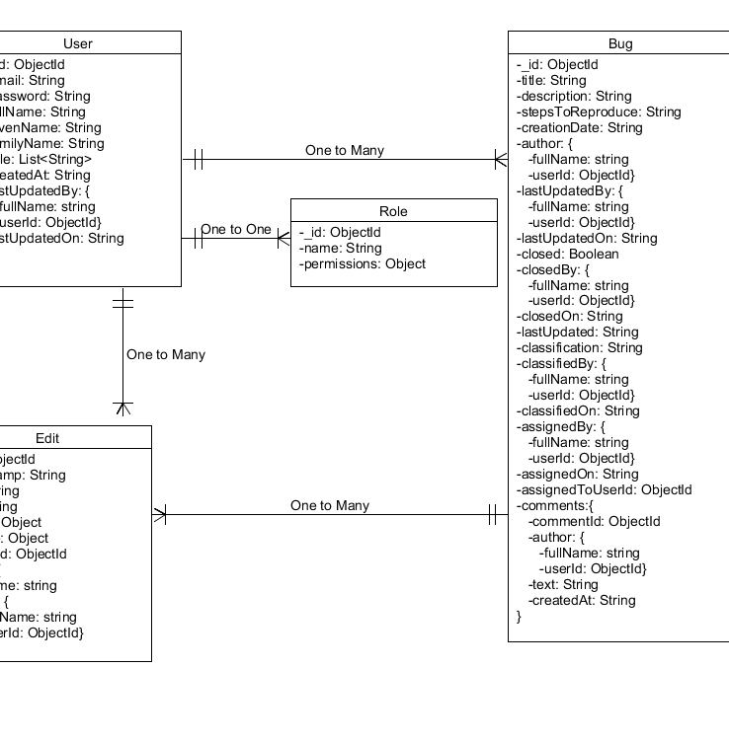
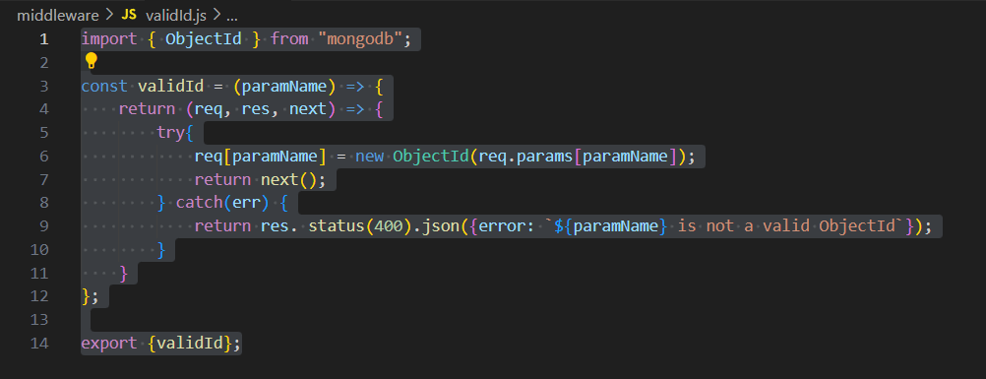
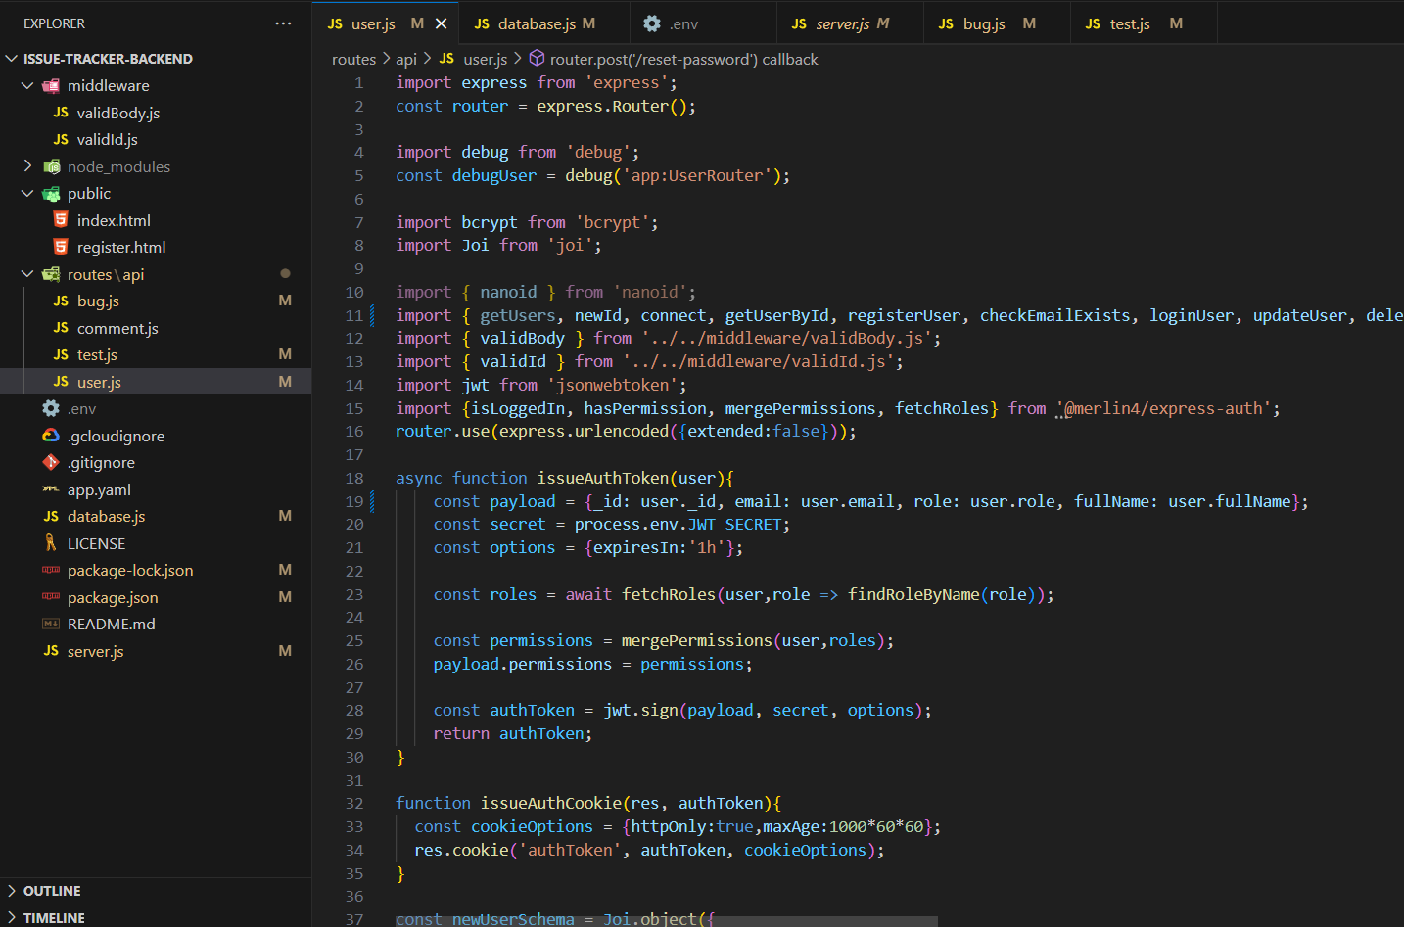
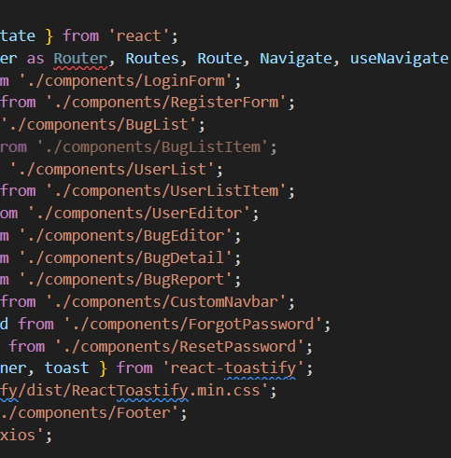
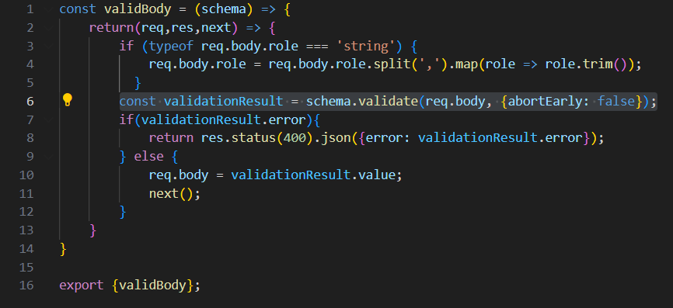
Layers

Slide 4

But What does it do?

Slide 5
Database of Users
Database of Bugs
Edit/Add Bugs/Users

Slide 6
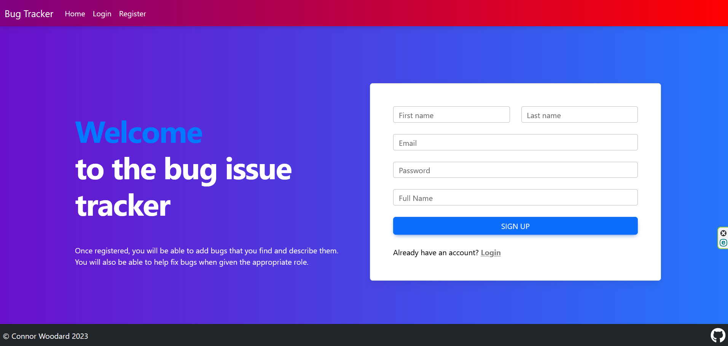
Live Demo

